Slide 1
SPI
Manager: Tom Aendekerk Speaker: Tom Aendekerk

Slide 2
General description of bus
The Serial Peripheral Interface is a synchronous serial communication interface specification used for short-distance communication, primarily in embedded systems (electronic system that has software and hardware integrated).
Uses shift register, data stored shifts from one location to the next.
When everything doesn’t have to happen at once.
Camera lenses (Canon EF lens mount), Memory (flash), Real-time clocks, sensors (temperature, pressure, touchscreens…)

Slide 3
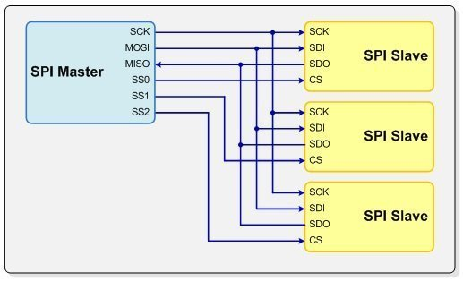
Characteristics
Wiring ----------------------------------------------------→
Speed: Varying between 1MHZ-100MHZ
Max length: About 10 meters
Use: By microcontrollers

Slide 4
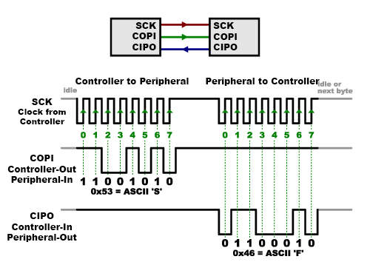
Special feature/remarks/examples
It’s synchronous. Uses seperate lines for data and a clock that keeps both sides in perfect sync
The controller knows in advance when the peripheral will send back data and how much data this will be
Can be much simpler and cheaper

Slide 5
Sources/References Used
Wikipedia SPI: https://en.wikipedia.org/wiki/Serial_Peripheral_Interface
Netburner: https://www.netburner.com/learn/spi-what-it-is-how-it-works/
Learn.sparkfun: https://learn.sparkfun.com/tutorials/serial-peripheral-interface-spi/all

